Slide 1
Newton’s Laws of Motion Review
Newton’s First Law (The Law of Inertia):
If there is no net force on an object, then the object will maintain a state of _________or _________________
v
Newton’s Second Law:
If there is a net force acting on an object, then the object will accelerate in the direction of the net force.
The acceleration is directly proportional to the net force and inversely proportional to the object mass.
v

Slide 2
Newton’s Third Law (Action-Reaction):
If object A exerts a force on object B, then object B exerts an equal and opposite force on object A.
v
Example 1: Applying Newton’s First Law:
Seatbelts are important safety devices in cars. If a car moving on a highway at 100 km/h Forward, comes to a sudden stop, we need seatbelts because the driver’s body will:
a) Stop before the car stops and the seat will run into them
b) Continue moving forward at 100 km/h when the car stops and will hit the dashboard
c) Begin moving backwards when the car stops and will hit the back window
d) Begin to accelerate forward when the car stops and will hit the dashboard

Slide 3
Force of Gravity on Earth
There is a force of attraction between the Earth and all objects with mass near the Earth’s surface.
To find the force of gravity due to the Earth, acting on an object of mass, m is:
m is mass in kg
g is the gravitational field strength near the Earth’s surface (9.80 N/kg [toward’s centre of Earth]
Fg is the force in Newtons
v

Slide 4
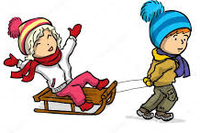
Newton’s Law Sample Question:
A child on a toboggan (total mass 56.0 kg) is being pulled along level ground with an applied force of 85.0 N [East]. There is a force of kinetic friction of 67.0 N [West]. find:
The net force on the toboggan.
The toboggan’s state of motion (constant velocity or acceleration). If the toboggan is accelerating, determine the magnitude and direction of the acceleration.
Ans: 18.0 N [E], 0.321 m/s² [E]

Slide 5
Example 3:
According to Newton's second law of motion, acceleration is proportional to net force. That means that if you keep the mass constant and DOUBLE the net force, the acceleration will
Stay the same
Become half as large
Become twice as large
Become four times as large

Slide 6
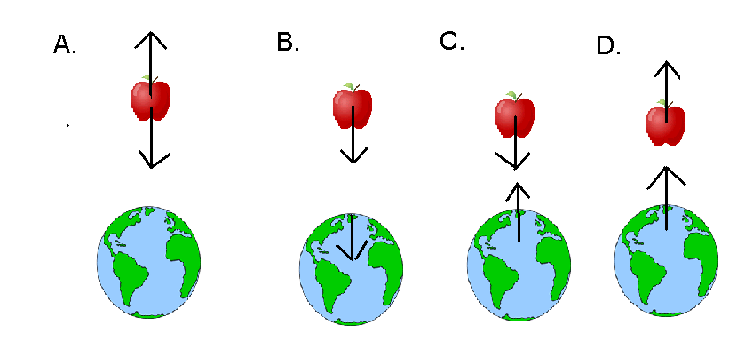
Example 4: Applying Newton’s Third Law:
A child pulls a wagon applying a force of 55 N East on the wagon. The force the wagon applies on the child is:
a) 55 N West if the wagon is moving at a constant velocity.
b) Less than 55 N West if the wagon is slowing down.
c) More than 55 N West if the wagon is speeding up.
d) 55 N West regardless of the wagon’s speed.
Example 5: Applying Newton’s Third Law:
Which diagram below correctly shows the action-reaction forces between the Earth and
an apple on a tree?

